Slide 1


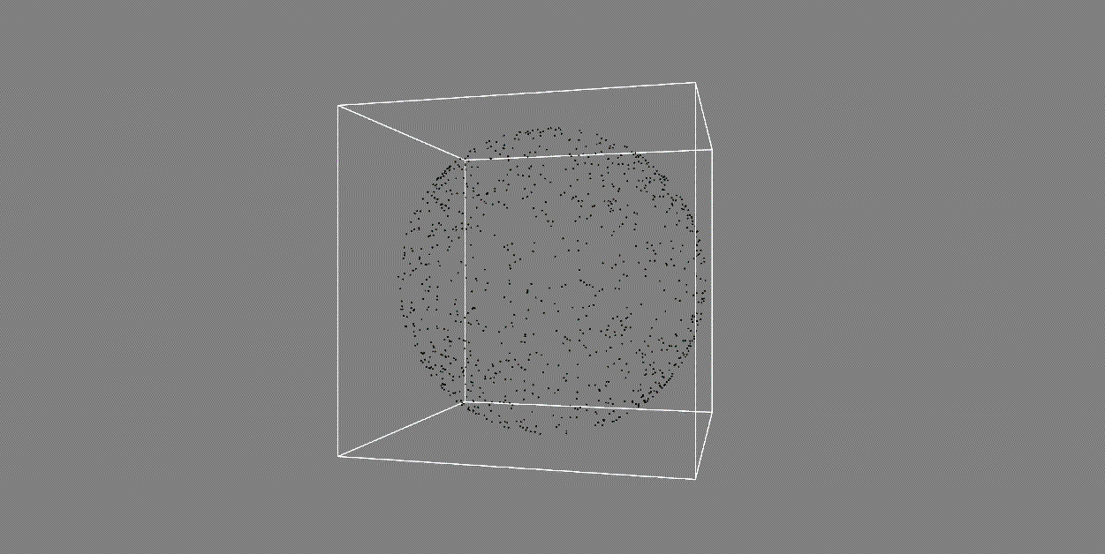

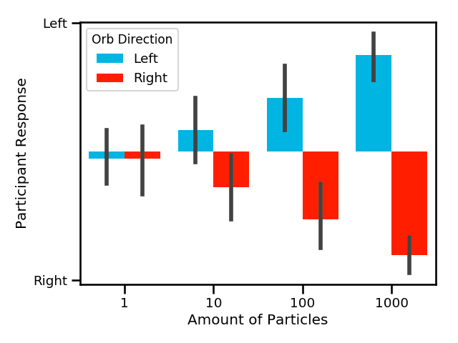

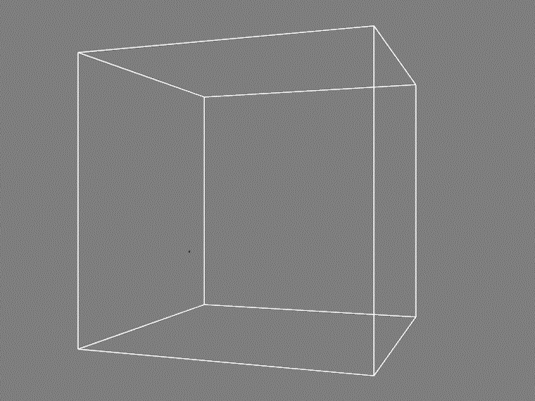
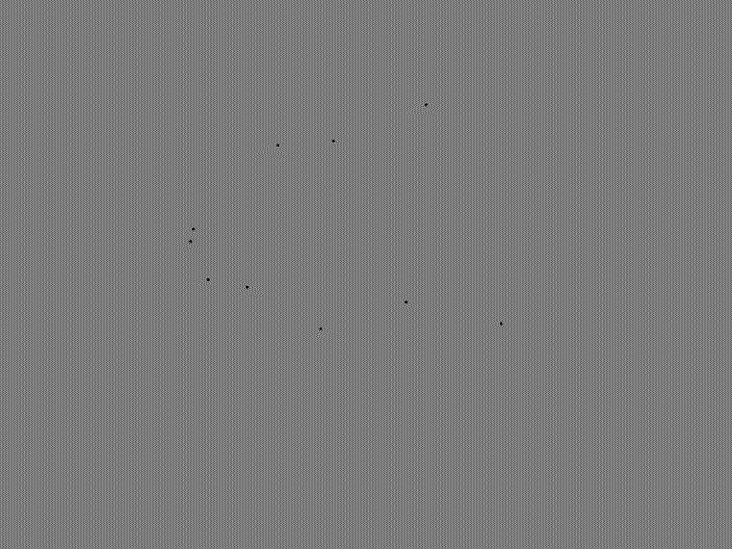
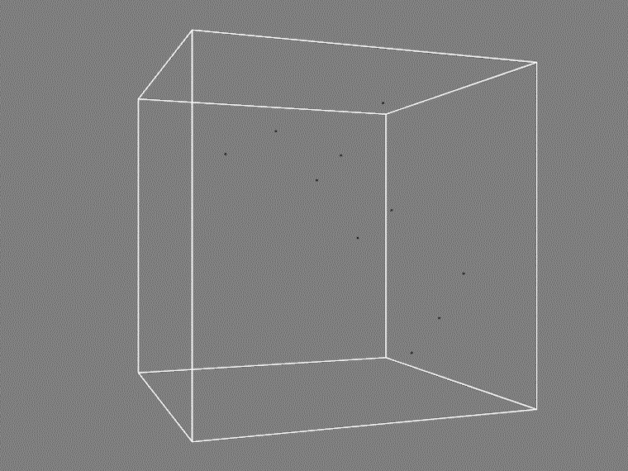

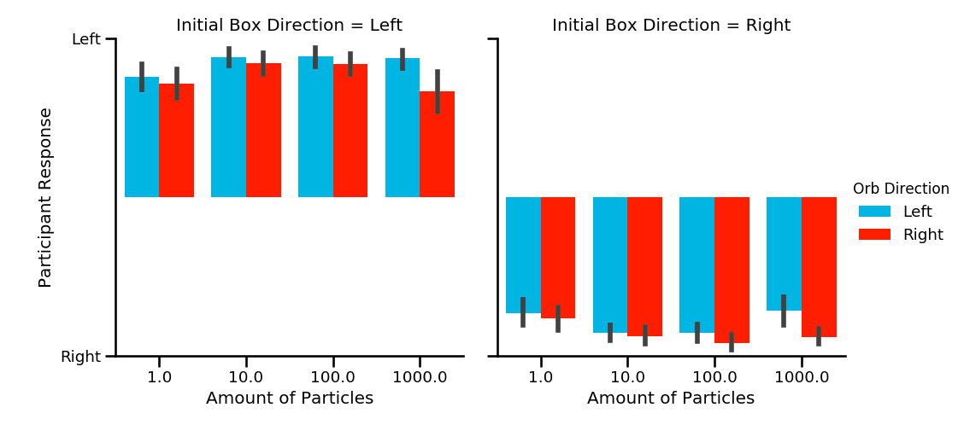
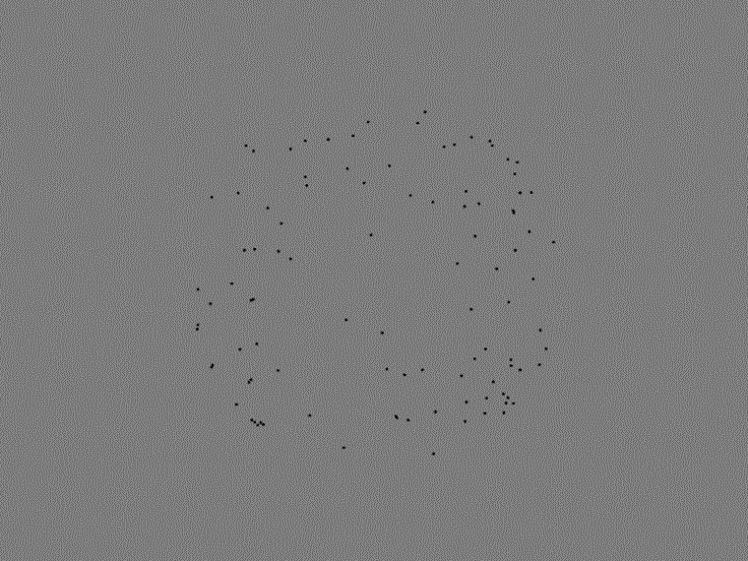
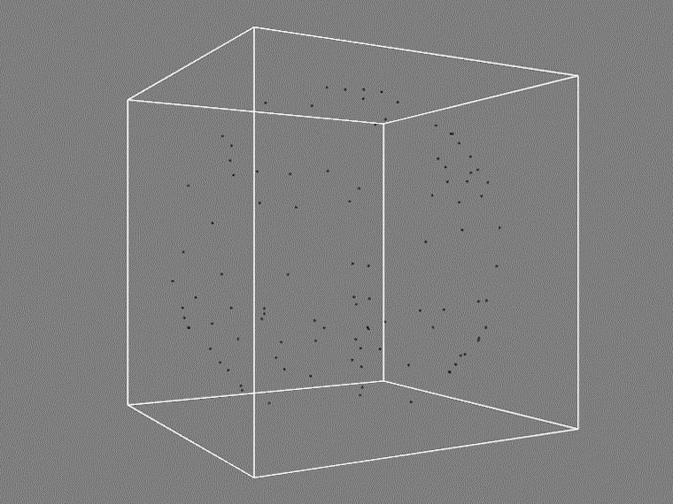
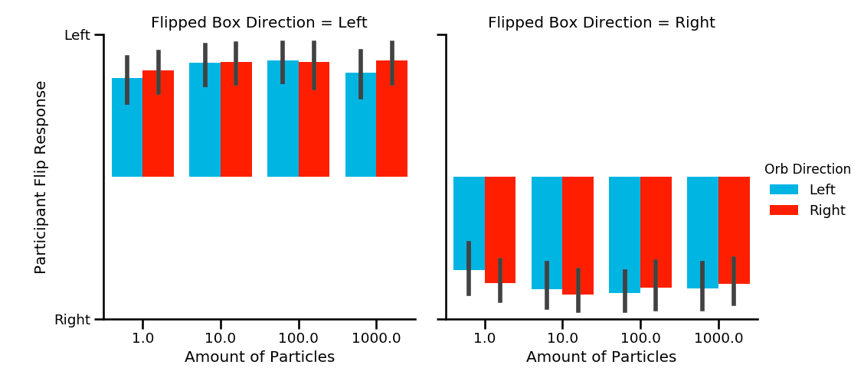
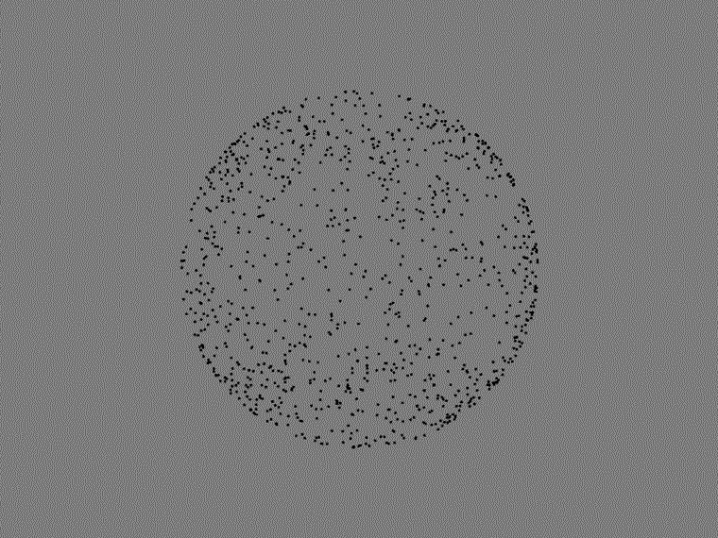
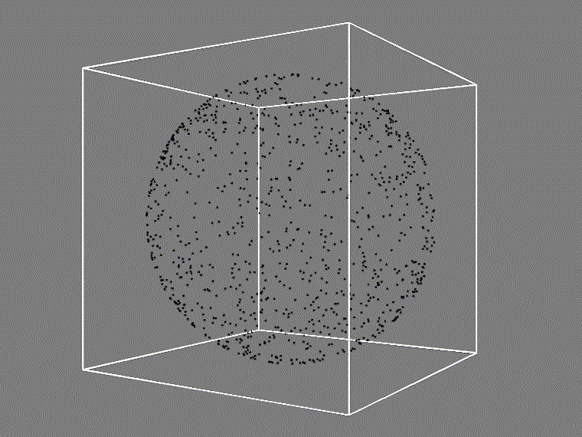

Perception of ambiguous motion biased by dimensional cues
JOSHUA R. WARREN, JOSHUA E. ZOSKY, MICHAEL D. DODD UNIVERSITY OF NEBRASKA-LINCOLN
ORB ORB + Z-BOX
1 PARTICLE
10 PARTICLES
Perception of ambiguous motion is biased by surrounding stimuli
Baseline test - orb alone
Participants were asked to judge the direction of motion for a 3D particle sphere
100 PARTICLES
Two phases:
Baseline test - orb alone
Secondary test – orb with 3D cube
Secondary test – orb with 3D cube
If motion of orb changed, participants were instructed to update perception judgement
1000 PARTICLES
EMAIL: JOSHUA.E.ZOSKY@GMAIL.COM
MORE DEMOS: http://imnotamember.github.io/opticalillusionvideos.html
Supported by NSF/EPSCoR grant #1632849 to MDD, TJV, and colleagues.
Secondary test – orb with 3D cube, 2nd spin

